Slide 1
Emotion Based Music Player
Title

Slide 2
Contents
Problem Statement
Abstract
Introduction
Literature Survey
System Design
Methodology
Algorithm
Modules
Software Tools & Technology
Experimental Results
Performance Evaluation
Test Cases
Conclusion
References
Project Plan 4.0

Slide 3
Problem Statement
To Design and Develop a system where the music is played depending about the emotion shown by the facial expression and lyrics given by user.

Slide 4
Abstract
The human face is an important organ of an individual ‘s body and it especially plays an important role in extraction of an individual‘s behavior and emotional state.
Manually segregating the list of songs and generating an appropriate playlist based on an individual‘s emotional features is a very tedious, time consuming, labor intensive and upheld task.
However the proposed existing algorithms in use are computationally slow, less accurate and sometimes even require use of additional hardware like EEG or sensors.
This proposed system based on facial expression extracted will generate a playlist automatically thereby reducing the effort and time involved in rendering the process manually.
Thus the proposed system tends to reduce the computational time involved in obtaining the results and the overall cost of the designed system, thereby increasing the overall accuracy of the system.
Facial expressions are captured using an inbuilt camera.
The accuracy of the emotion detection algorithm used in the system for real time images is calculated.

Slide 5
Introduction
Manually segregating the list of songs and generating an appropriate playlist is difficult and time consuming.
The human face is an important organ of an individual ‘s body
It especially plays an important role in extraction of an individual‘s behavior and emotional state.
Manually segregating the list of songs and generating an appropriate playlist based on an individual‘s emotional features is a very tedious, time consuming, labor intensive and upheld task.
Various algorithms have been proposed and developed for automating the playlist generation process.

Slide 6
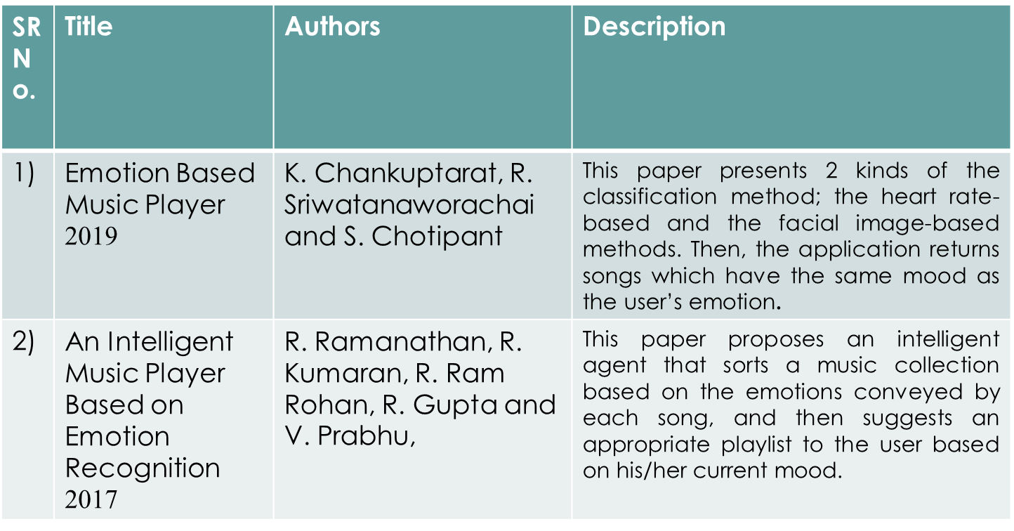
Literature Survey

Slide 7
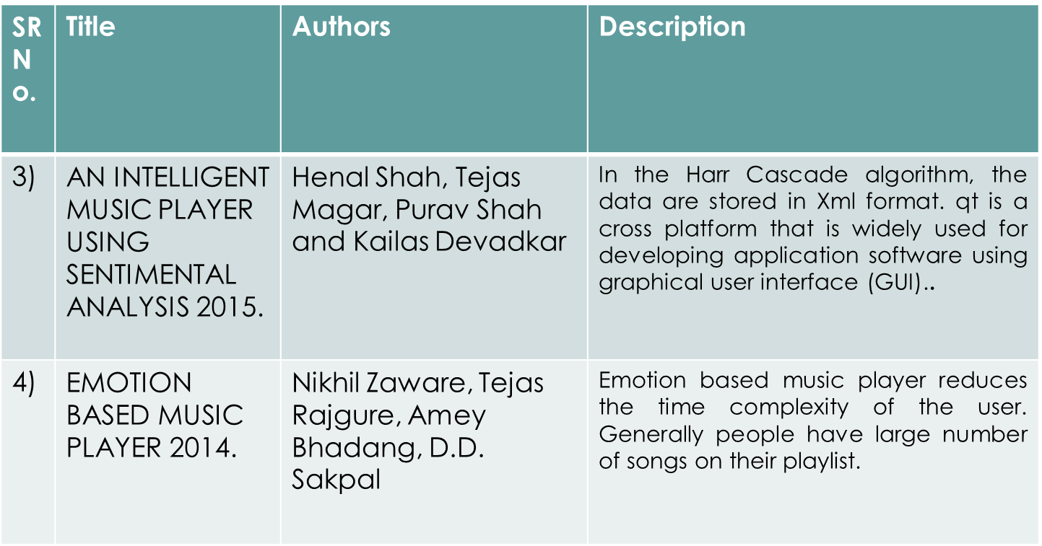
Literature Survey

Slide 8
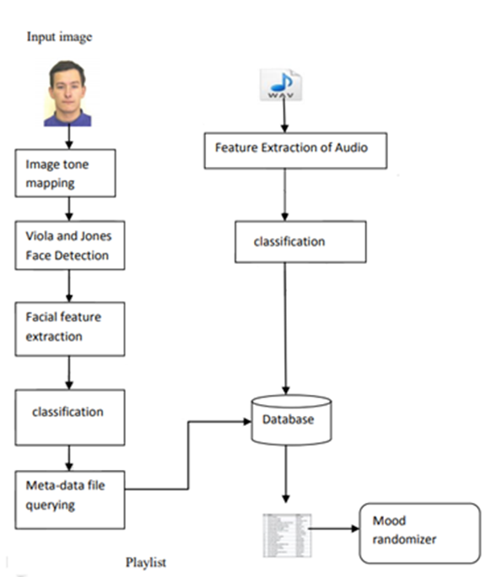
System Design

Slide 9
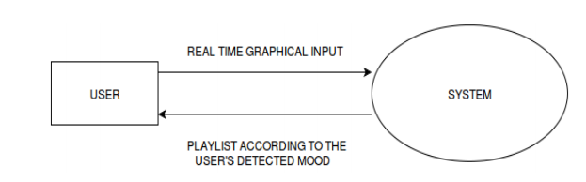
DFD Level 0

Slide 10
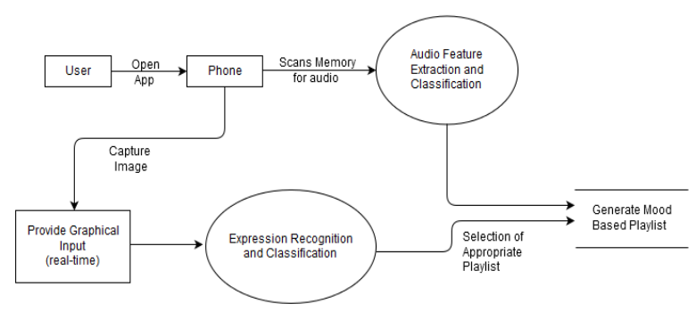
DFD Level 1

Slide 11
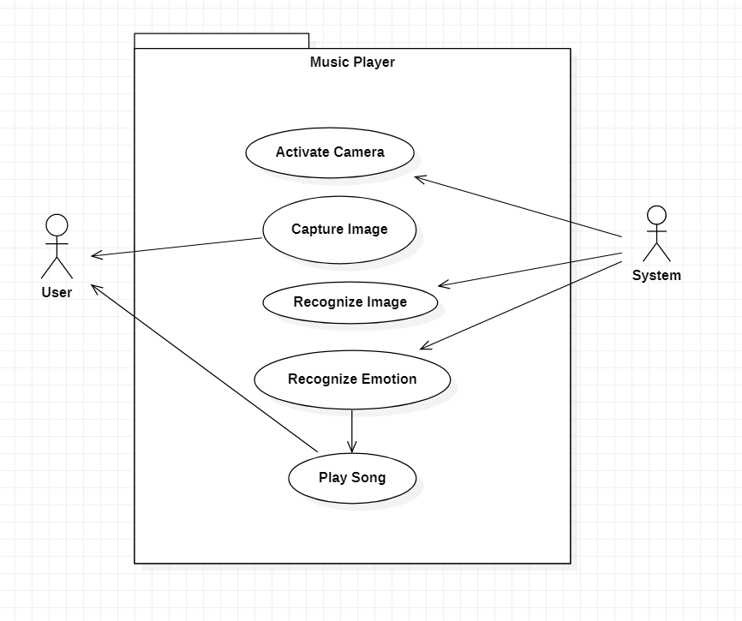
UML Diagram - Use Case

Slide 12
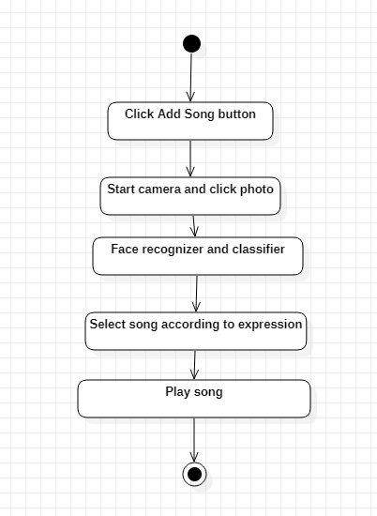
UML Diagram - Activity

Slide 13
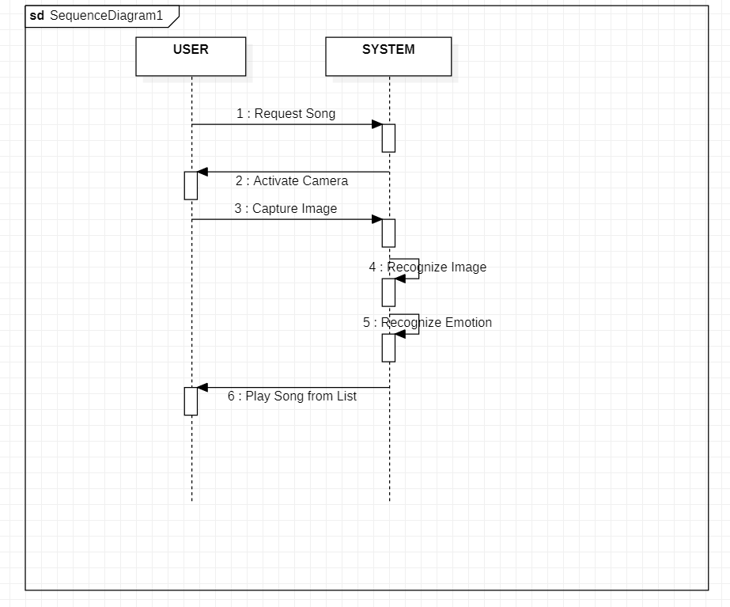
UML Diagram - Sequence

Slide 14
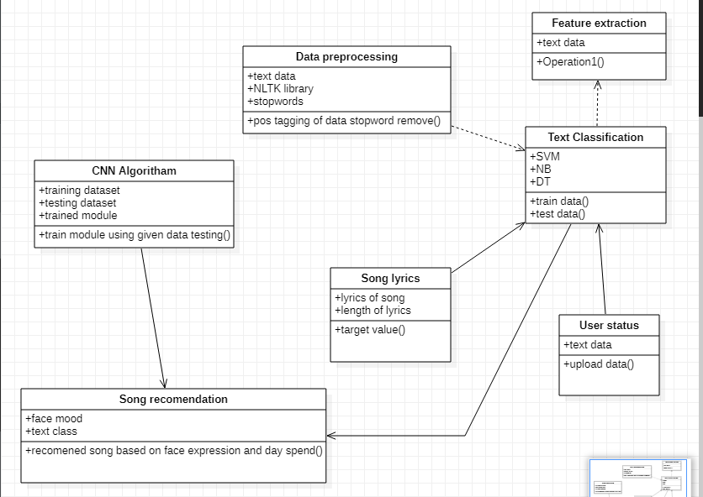
UML Diagram - Class

Slide 15
Methodology
User will give input in text or in speech format mostly in speech format that speech will get converted into a text and that text send to server in json format for analyzed and emotions are get calculated for it as well as keyword search is happened for that that result return millions of songs that songs will again get filter under collaboration filter this result optimized to hundred and that hundred again sent to mobile and based on the user profile it will be sorted in the 20 to 30 songs.
First step the emotions and keyword are consider and based on that most likely data which other users had listened is get extracted that will reduce a cold start problem as we have all data already prepared that data again sorted based on the user contend or profile which consider the most listened genres , musician , song types , music year , duration , listen count ,singer and emotions

Slide 16
Module 1 : Face Recognition
Image is Captured through Image itself or Video Input.
These Images takes in inputs, which are then processed in hidden layers of network using weights that are adjusted during training.
Face is detected from image. Locate one or more faces in the image and mark with a bounding box.
Feature Extraction. Extract features from the face that can be used for the
recognition task.
Emotion Recognition. Perform matching of the face against one or more known faces in a prepared database.

Slide 17
Module 2 : Lyrics Classification
Lyrics are classified though the emotion recognized by first module.
This feature helps to classify songs which are sad , happy etc.

Slide 18
Module 4 : Songs Recommendations
In this module a list of songs are recommended according to the expression recognized and lyrics classified through same.

Slide 19
Module 3 : Text Classification
In this module text is classified of the answer given by user and accordingly the text is recognized.
Example: how was your day
“The day was nice”..

Slide 20
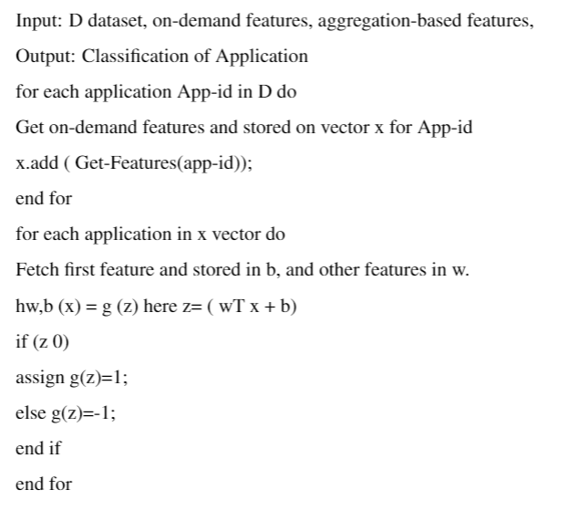
Algorithm – SVM

Slide 21
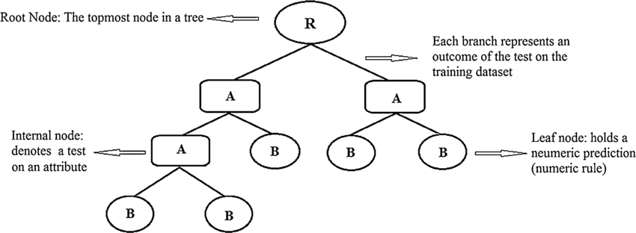
Algorithm – Decision Tree

Slide 22
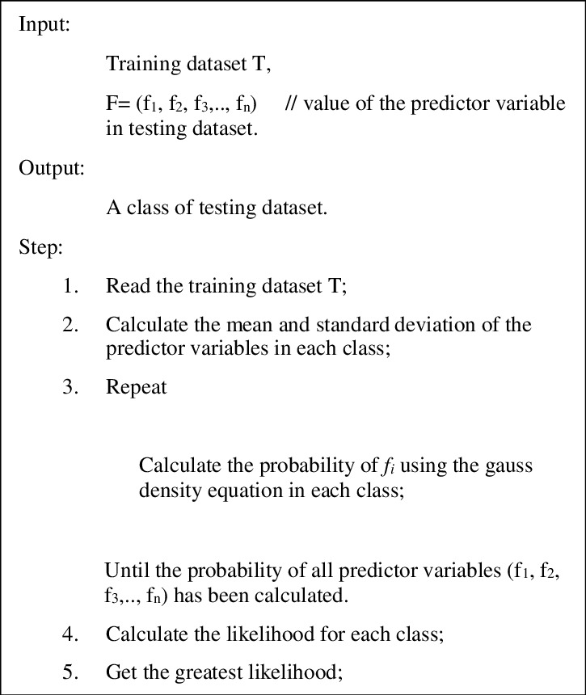
Algorithm – Naïve Bayes

Slide 23
Algorithm (Random Forest)
Random Forest algorithms are used for classification as well as regression.
It creates a tree for the data and makes prediction based on that.
Random Forest algorithm can be used on large datasets and can produce the same result even when large sets record values are missing.
The generated samples from the decision tree can be saved so that it can be used on other data.
In random forest there are two stages, firstly create a random forest then make a prediction using a random forest classifier created in the first stage.

Slide 24
Software Tools & Technology
Hardware
Hard Disk : 200 GB
RAM: 8 GB
Processor : Intel Pentium i5 and above
GPU : Nvidia
Camera Speakers
Software Resources Required
Technology Used : Python
IDE: Python IDE
Operating System : Windows XP or above

Slide 25
Experimental Results

Slide 26
Performance Evaluation
Algorithms Used | Used For | Accuracy
SVM | Train Module for lyrics classification | 97.5%
NB | Train Module for lyrics classification | 94.2%
DT | Train Module for lyrics classification
RF | Train Module for lyrics classification

Slide 27
Performance
Open source library deep face | Python | For Recognition Of Facial FEature

Slide 28
Test Cases
 | Test Cases
 | Image Capture | Image Recognition,Blur | Fail
 | Image Capture | Image Recognition | Success
 | Classifying Lyrics | Music list not Loaded | Fail
 | Classifying Lyrics | Music List Loaded | Success

Slide 29
Status
Project Thesis : Soft copy Ready
Publication : Published

Slide 30
Conclusion
The Emotion-Based Music Player is used to automate and give a better music player experience for the end user. The application solves the basic needs of music listeners without troubling them as existing applications do: it uses technology to increase the interaction of the system with the user in many ways. It eases the work of the end-user by capturing the image using a camera, determining their emotion, and suggesting a customized play-list through a more advanced and interactive system. The user will also be notified of songs that are not being played, to help them free up storage space.
After analysis of algorithms, SVM is best classifier for classifying lyrics .

Slide 31
References
[[1]K. Chankuptarat, R. Sriwatanaworachai and S. Chotipant, ”EmotionBased Music Player,” 2019 5th International Conference on Engineering, Applied Sciences and Technology (ICEAST), Luang Prabang, Laos, 2019, pp. 1-4,
[2]R. Ramanathan, R. Kumaran, R. Ram Rohan, R. Gupta and V. Prabhu, ”An Intelligent Music Player Based on Emotion Recognition,” 2017 2nd International Conference on Computational Systems and Information Technology for Sustainable Solution (CSITSS), Bengaluru, India, 2017, pp. 1-5,
[3]Hafeez Kabini, Sharik Khan, Omar Khan, Shabana Tadvi “EMOTION BASED MUSIC PLAYER” International Journal of Engineering Research and General Science, Volume 3, Issue 1, 2015.
[4]Nikhil Zaware, Tejas Rajgure, Amey Bhadang, D.D. Sakpal “EMOTION BASED MUSIC PLAYER” International Journal of Innovative Research Development, Volume 3, Issue 3, 2014.
[5]Setiawardhana, Nana Ramadijanti, Peni Rahayu “FACIAL EXPRESSIONS RECOGNITION USING BACKPROPAGATION NEURAL NETWORK FOR MUSIC PLAYLIST ELECTIONS” Jurnal Ilmiah Kursor, Volume 6, Issue 3, 2012.
[6]Henal Shah, Tejas Magar, Purav Shah and Kailas Devadkar “AN YSIS” International Journal of Innovative and Emerging Research in Engineering, Volume 2, Issue 4, 2015.

Slide 32
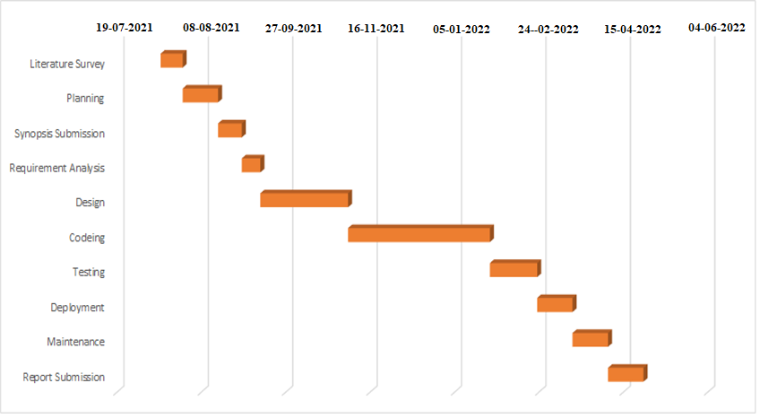
Project Plan 4.0

